Slide 2
© 2022 Mfinity Global. All rights reserved. This video or any portion of this presentation may not be reproduced, duplicated, copied, sold, resold, or otherwise exploited for any commercial purpose that is not expressly authorized by Mfinity Global. Except as expressly provided herein, Mfinity Global does not grant you any express or implied rights under any patents, copyrights, trademarks, trade secret, or other intellectual or industrial property rights.
Any product information contained herein has not been evaluated by the FDA. Mfinity’s products are not intended to diagnose, treat, cure, or prevent any disease. Mfinity Global does not offer medical advice of any kind. Always consult your personal physician or other medical professional prior to starting, stopping, or adjusting any medications or starting any diet, exercise, or nutritional supplement program.
The MFIT Challenge is a comprehensive system promoting an active ketogenic lifestyle, which includes meal replacement products and nutritional supplements along with dietary and exercise guidance. The average weight loss expectation is approximately 1-2 lbs. per week, up to 15 lbs. total. Any weight loss in excess of these amounts, although not uncommon, should not be considered as typical, and would require exceptional circumstances and or efforts. Individual results can and will vary dependent upon many factors.
Mfinity would never knowingly promote a questionable or false testimonial. Please note that the testimonials shared herein may be from independent distributors that seek to benefit from the sales of referenced products. Please refer to mfinityglobal.com or call 801-679-4792 for more information on individual products.
Any income illustrations contained herein are for informational purposes only and are not intended to serve as a guarantee of income. Any projections presented to you prior to, or after your enrollment, are not necessarily representative of the income, if any, that you can or will earn through your participation in the Compensation Plan. Success in this business requires hard work, dedication and good sales skills. The average participant in this business earns between $500 and $2,000 per year. Some earn less while some earn much more.
Please see mfinityglobal.com for individual product and income disclosure statements.

Slide 3
WELCOME TO YOUR
LIFE!

Slide 4
Change your LIFE with PROVEN products
BECOME HEALTHY
LOSE WEIGHT
GET FIT
The MFIT Challenge is a comprehensive system promoting an active ketogenic lifestyle, which includes meal replacement products and nutritional supplements along with dietary and exercise guidance. The average weight loss expectation is approximately 1-2 lbs. per week, up to 15 lbs. total. Any weight loss in excess of these amounts, although not uncommon, should not be considered as typical, and would require exceptional circumstances and or efforts. Individual results can and will vary dependent upon many factors. Mfinity would never knowingly promote a questionable or false testimonial. Please note that the testimonials shared herein may be from independent distributors that seek to benefit from the sales of referenced products.

Slide 5
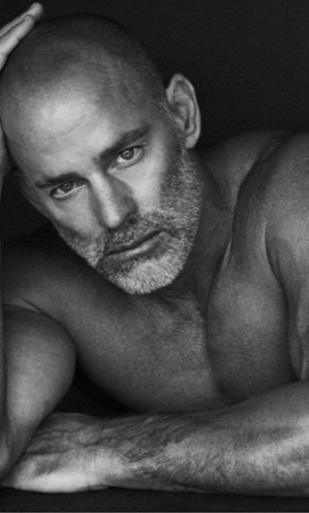
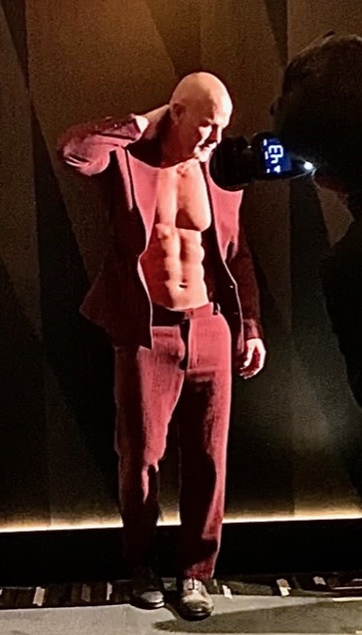
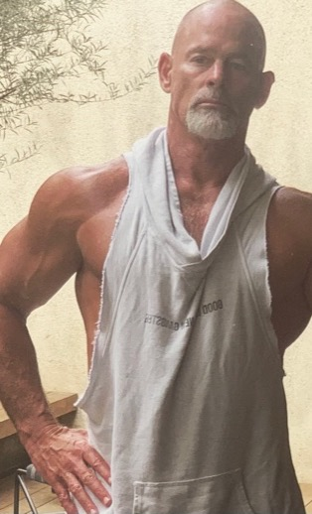
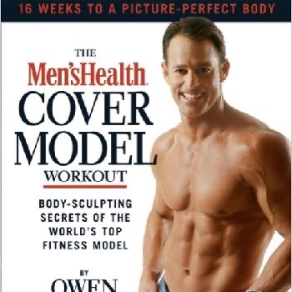
Get coached by top celebrity trainers
OWEN MCKIBBIN
KRISTY KAMINSKI-MILLS
MFIT Coach, 17 Time Men’s Health Cover Model, Fitness Expert, Athlete, Celebrity Personal Trainer of Zac Efron and Blake Lively to Jessica Simpson, Amber Valetta, Penn Badgley, and Brooke Burke
MFIT Coach, Former FORD Model, Runway Model, Personal Trainer, The Bachelor Contestant, Health Expert, Entrepreneur

Slide 6
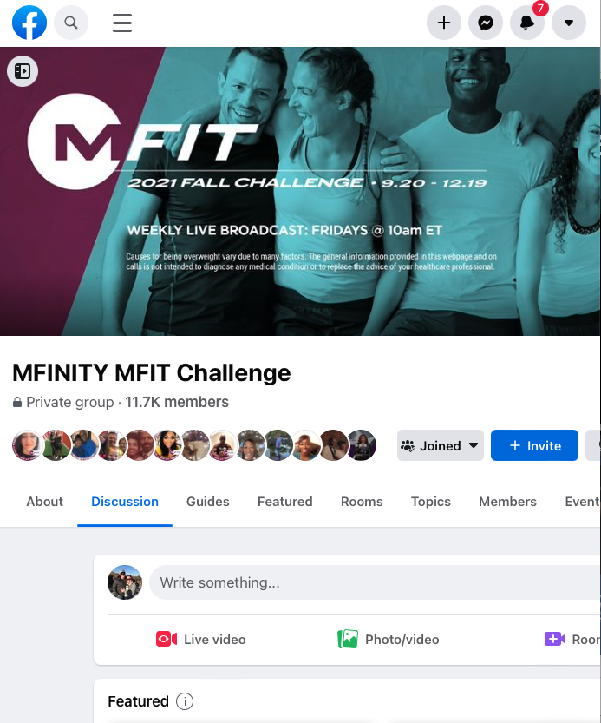
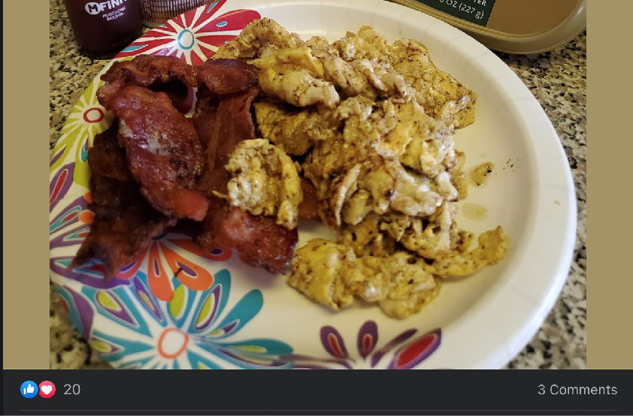
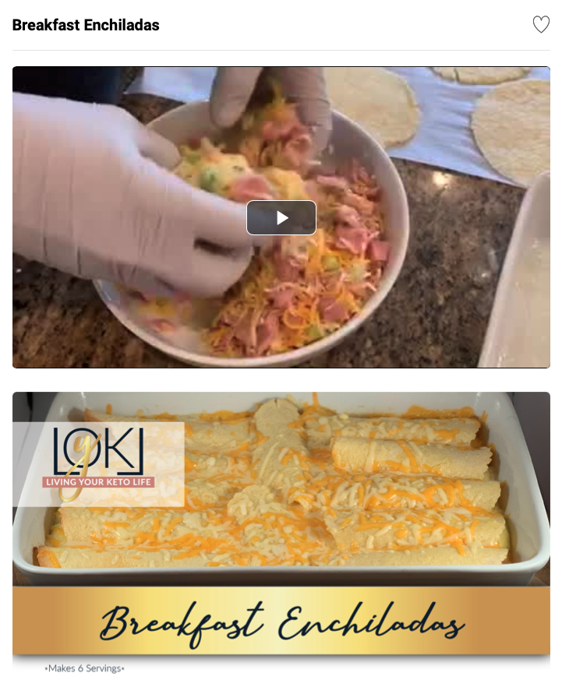
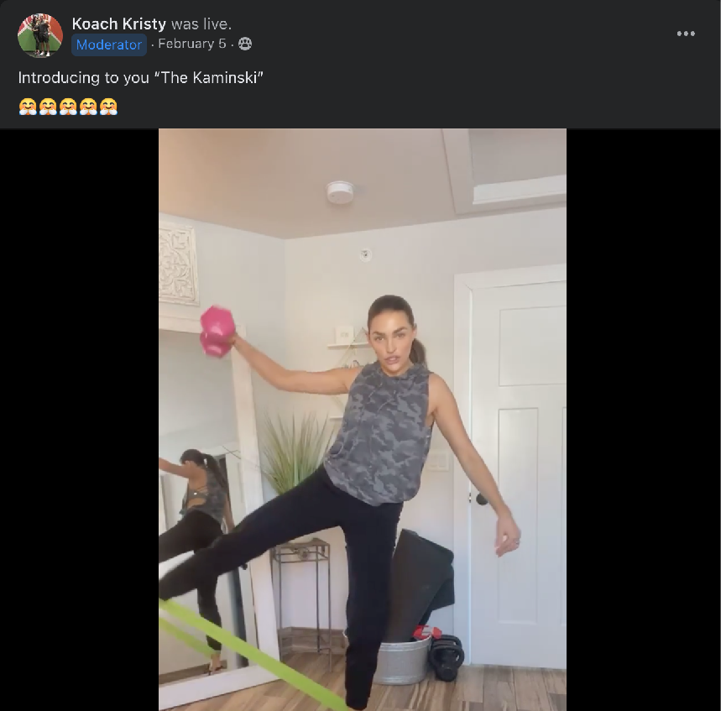
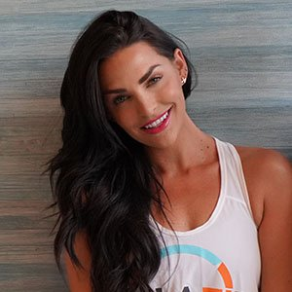
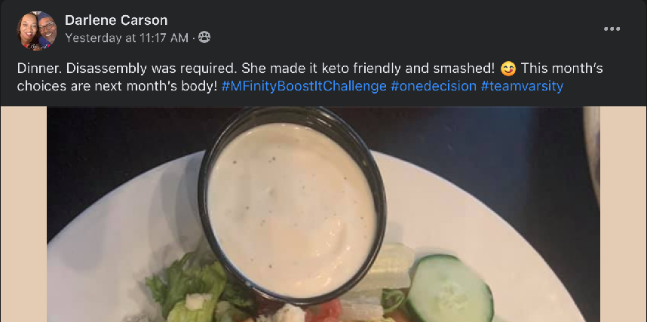
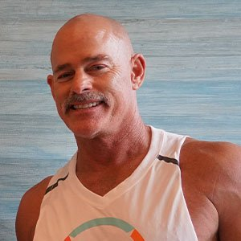
With the world’s most supportive community
Weekly Training on LIVE’s and Conference Calls with our Celebrity Trainers and Honorary Coaches
Online MFIT cooking demos & seminars with MFIT Celebrity Chefs and Food Science Doctors
The MFIT Challenge is a comprehensive system promoting an active ketogenic lifestyle, which includes meal replacement products and nutritional supplements along with dietary and exercise guidance. The average weight loss expectation is approximately 1-2 lbs. per week, up to 15 lbs. total. Any weight loss in excess of these amounts, although not uncommon, should not be considered as typical, and would require exceptional circumstances and or efforts. Individual results can and will vary dependent upon many factors. Mfinity would never knowingly promote a questionable or false testimonial. Please note that the testimonials shared herein may be from independent distributors that seek to benefit from the sales of referenced products.

Slide 7
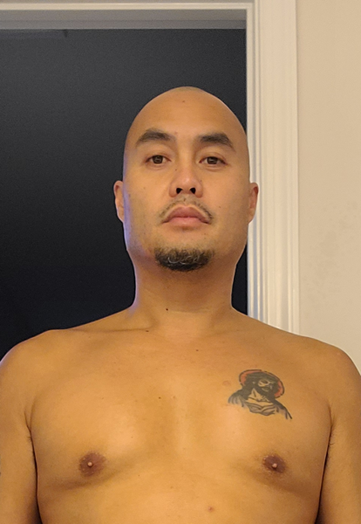
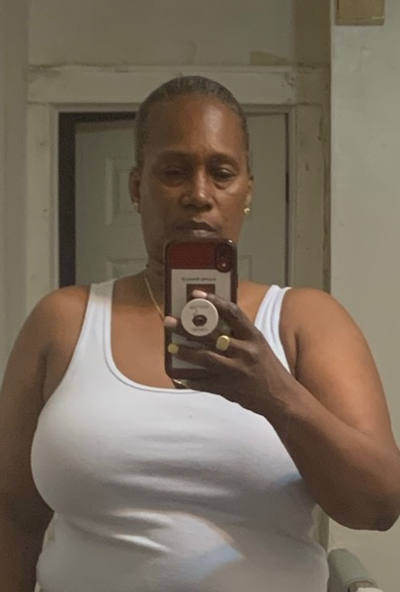
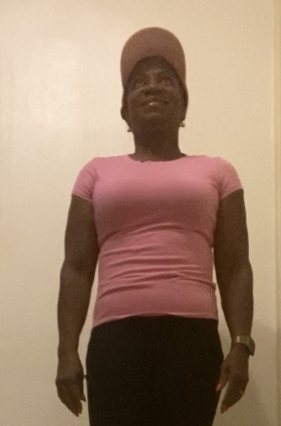
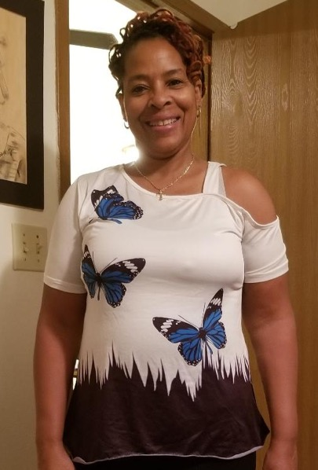
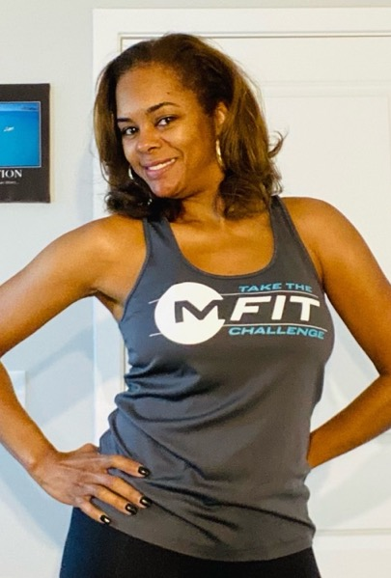
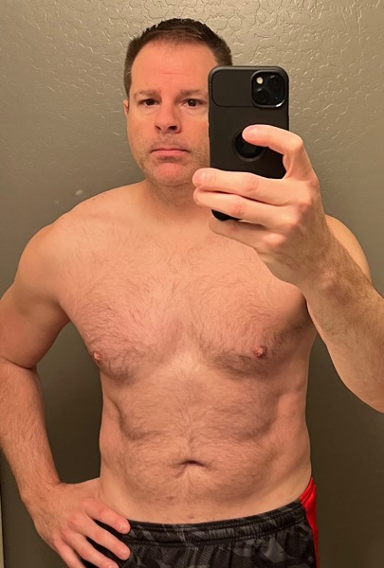
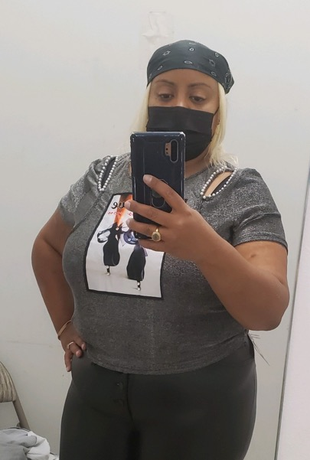
Real Results for Real People
Michele Morris
Hervin Carillo
Pilar DeJesus
Connie Upshur
Anestine Etienne
Simone Johnson
Renee Brown
Ken
Carling
Tien Buttons Reid
The MFIT Challenge is a comprehensive system promoting an active ketogenic lifestyle, which includes meal replacement products and nutritional supplements along with dietary and exercise guidance. The average weight loss expectation is approximately 1-2 lbs. per week, up to 15 lbs. total. Any weight loss in excess of these amounts, although not uncommon, should not be considered as typical, and would require exceptional circumstances and or efforts. Individual results can and will vary dependent upon many factors. Mfinity would never knowingly promote a questionable or false testimonial. Please note that the testimonials shared herein may be from independent distributors that seek to benefit from the sales of referenced products.

Slide 8
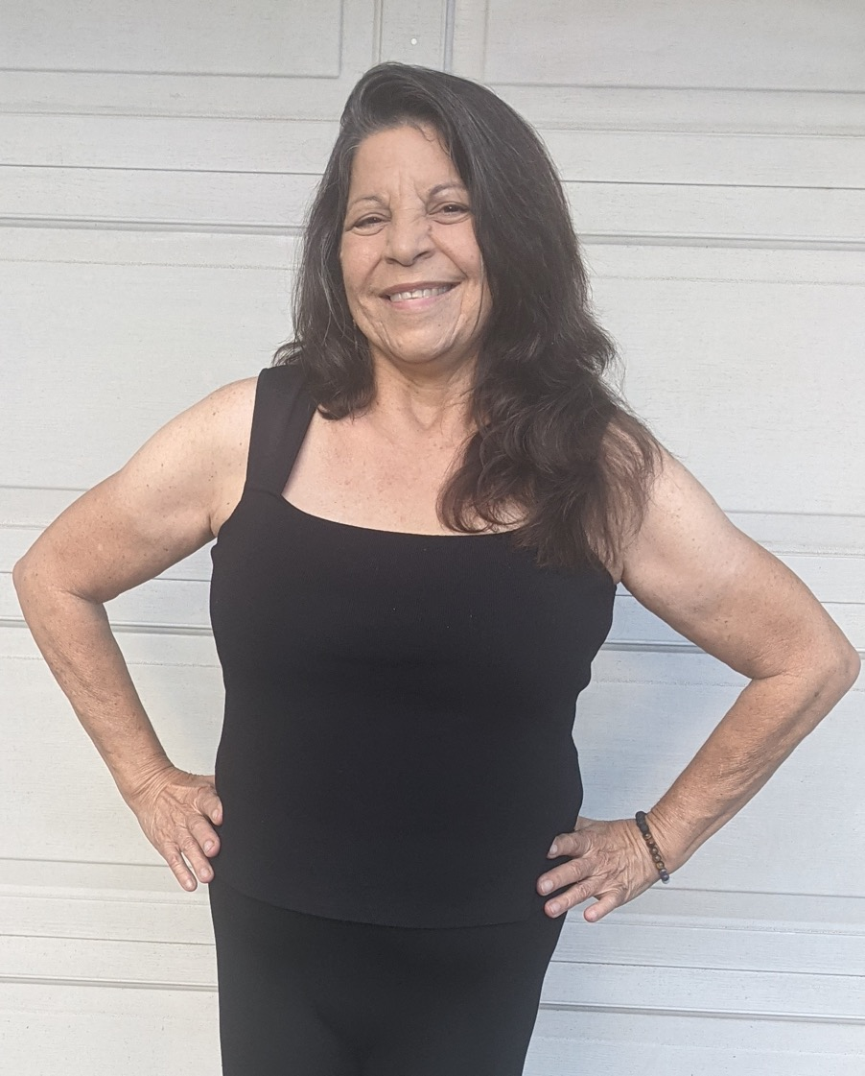
Core Health CHAMPION
JoAnn Miranda-Paiva
I feel balanced and it gives me great joy & satisfaction when people notice that I'm not limping & struggling to move due to my previous years of struggling with Sciatica. I now sleep well, get up & go easily, active all day, work in my yard but most importantly play with my 3 grandchildren.
I am forever grateful for these High Impact products that have truly made a difference in my life. "I can walk with ease"!
Mfinity would never knowingly promote a questionable or false testimonial. Please note that the testimonials shared herein may be from independent distributors that seek to benefit from the sales of referenced products.
The MFIT Challenge is a comprehensive system promoting an active ketogenic lifestyle, which includes meal replacement products and nutritional supplements along with dietary and exercise guidance. The average weight loss expectation is approximately 1-2 lbs. per week, up to 15 lbs. total. Any weight loss in excess of these amounts, although not uncommon, should not be considered as typical, and would require exceptional circumstances and or efforts. Individual results can and will vary dependent upon many factors

Slide 9
Core Health CHAMPION
Michael Butler
When I started my 1st challenge I was morbidly obese. At 354 pounds, I was miserable. I thank God for my wife finding this company and this challenge. My life has completely changed. I've gone from a 54 inch waist to a 36. I'm trying now to inspire others to do the same. Life is a one way trip. You'd better enjoy the ride while you can!
Mfinity would never knowingly promote a questionable or false testimonial. Please note that the testimonials shared herein may be from independent distributors that seek to benefit from the sales of referenced products.
The MFIT Challenge is a comprehensive system promoting an active ketogenic lifestyle, which includes meal replacement products and nutritional supplements along with dietary and exercise guidance. The average weight loss expectation is approximately 1-2 lbs. per week, up to 15 lbs. total. Any weight loss in excess of these amounts, although not uncommon, should not be considered as typical, and would require exceptional circumstances and or efforts. Individual results can and will vary dependent upon many factors

Slide 10
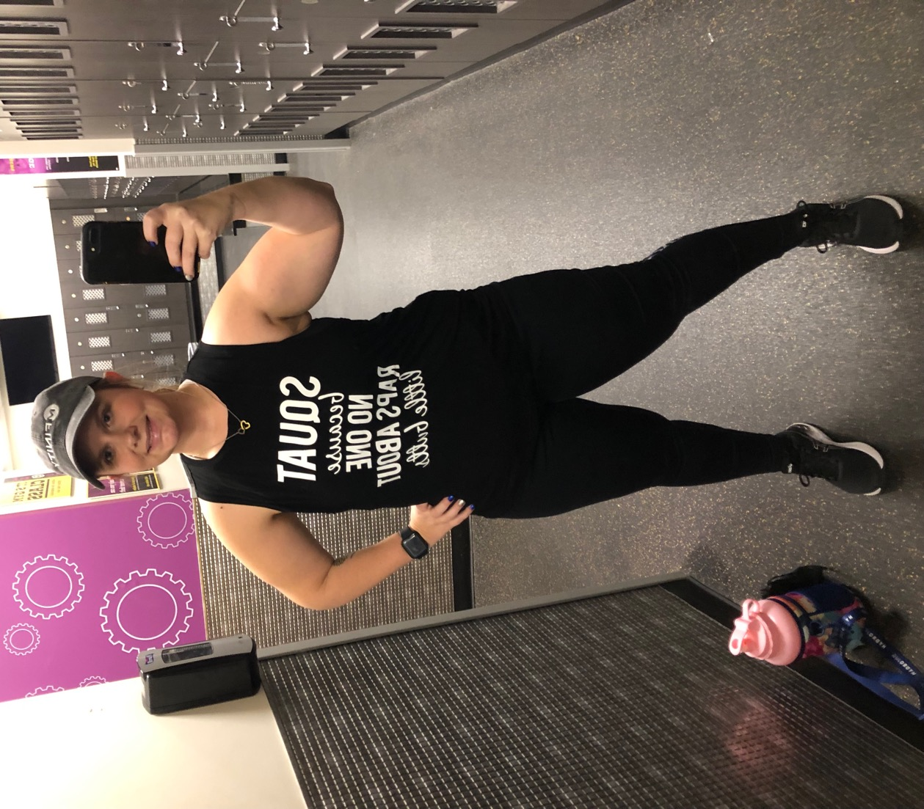
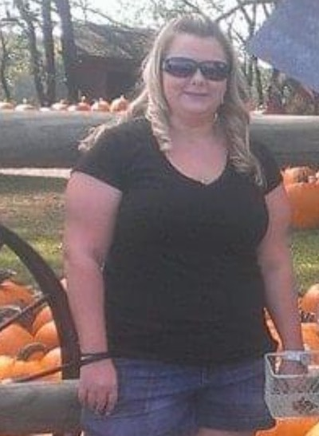
Fat Loss CHAMPION
Amanda Seech
49 total lbs lost
"These challenges have changed my health and have made me want to help people. This challenge was my favorite so far because I decided to be a captain. I was able to watch one of my good friends transform during this challenge and get closer to her goals. To see her success has been the best experience ever!"
Mfinity would never knowingly promote a questionable or false testimonial. Please note that the testimonials shared herein may be from independent distributors that seek to benefit from the sales of referenced products.
The MFIT Challenge is a comprehensive system promoting an active ketogenic lifestyle, which includes meal replacement products and nutritional supplements along with dietary and exercise guidance. The average weight loss expectation is approximately 1-2 lbs. per week, up to 15 lbs. total. Any weight loss in excess of these amounts, although not uncommon, should not be considered as typical, and would require exceptional circumstances and or efforts. Individual results can and will vary dependent upon many factors

Slide 11
Fat Loss CHAMPION
Elaine Green
60 total lbs. lost
“This time I feel the challenge steadily helps me get closer to my goal! The accountability makes the difference. For the new year I want to work more on my focus so that this next challenge will be my last one to reach my ultimate goal of 175 pounds. This additional loss of 35 pounds will be a dream come true. So I'm excited to have taken charge of myself and my health goals.”
Mfinity would never knowingly promote a questionable or false testimonial. Please note that the testimonials shared herein may be from independent distributors that seek to benefit from the sales of referenced products.
The MFIT Challenge is a comprehensive system promoting an active ketogenic lifestyle, which includes meal replacement products and nutritional supplements along with dietary and exercise guidance. The average weight loss expectation is approximately 1-2 lbs. per week, up to 15 lbs. total. Any weight loss in excess of these amounts, although not uncommon, should not be considered as typical, and would require exceptional circumstances and or efforts. Individual results can and will vary dependent upon many factors

Slide 12
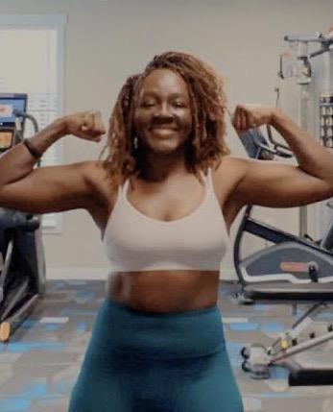
Fitness CHAMPION
Ezinne Nnorom
42 total lbs. lost
“You are worth it! You deserve to be happy, healthy, and to feel good! Taking The Challenge is a great way to help you get there and reach your goals!”
Mfinity would never knowingly promote a questionable or false testimonial. Please note that the testimonials shared herein may be from independent distributors that seek to benefit from the sales of referenced products.
The MFIT Challenge is a comprehensive system promoting an active ketogenic lifestyle, which includes meal replacement products and nutritional supplements along with dietary and exercise guidance. The average weight loss expectation is approximately 1-2 lbs. per week, up to 15 lbs. total. Any weight loss in excess of these amounts, although not uncommon, should not be considered as typical, and would require exceptional circumstances and or efforts. Individual results can and will vary dependent upon many factors

Slide 13
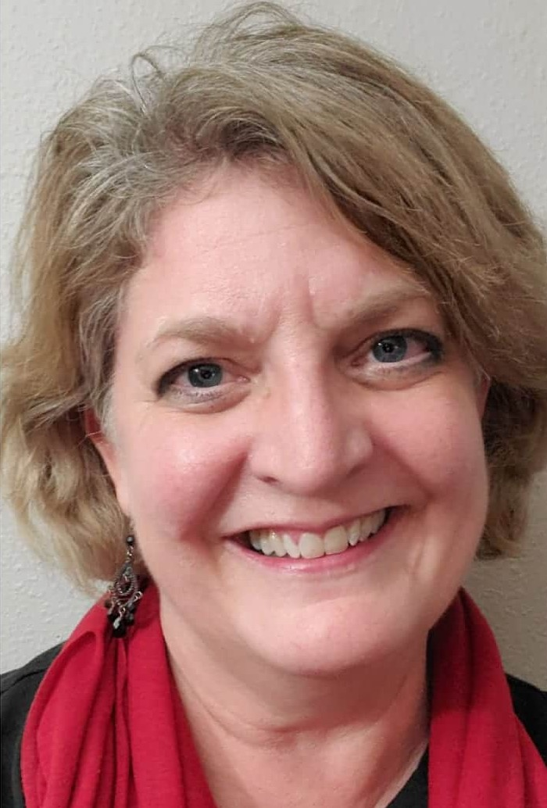
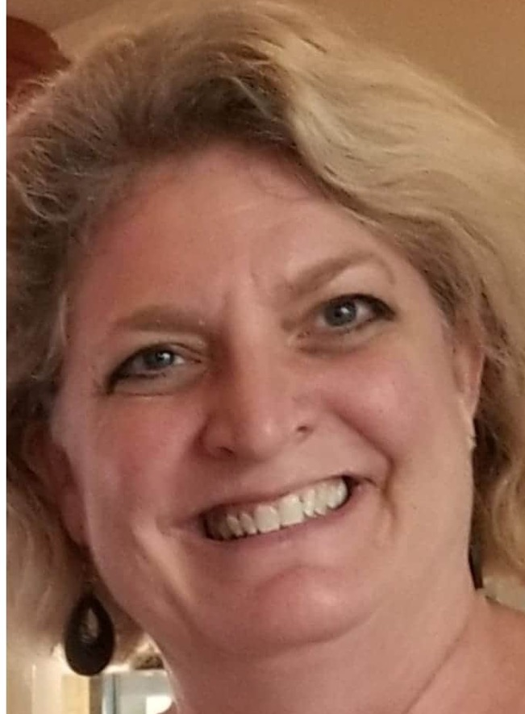
Fitness CHAMPION
Judy Marshall
77 total lbs. lost
“It has more than worked! I am 77 pounds down from my start. I am healthier than I've been in 12 years. I have energy that's ongoing day after day. I eat normal food. I sleep. I am pain free. I'm off all medications including sleep meds, blood pressure and cholesterol meds. I lean on these products to kick-start my days. They give me an emotional and stable balance all day long. I have 100% changed my relationship with food and movement. I am an MFIT lifer!”
Mfinity would never knowingly promote a questionable or false testimonial. Please note that the testimonials shared herein may be from independent distributors that seek to benefit from the sales of referenced products.
The MFIT Challenge is a comprehensive system promoting an active ketogenic lifestyle, which includes meal replacement products and nutritional supplements along with dietary and exercise guidance. The average weight loss expectation is approximately 1-2 lbs. per week, up to 15 lbs. total. Any weight loss in excess of these amounts, although not uncommon, should not be considered as typical, and would require exceptional circumstances and or efforts. Individual results can and will vary dependent upon many factors

Slide 14
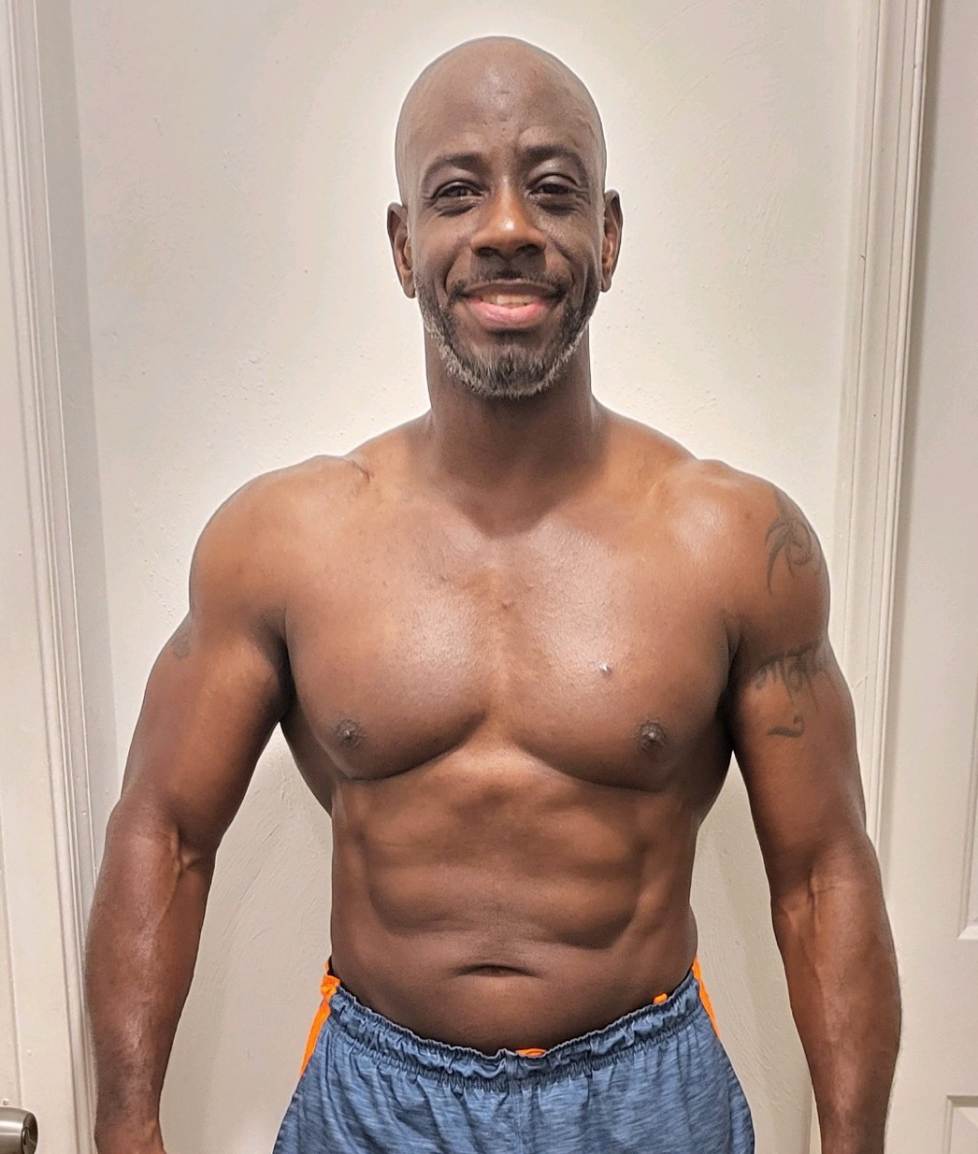
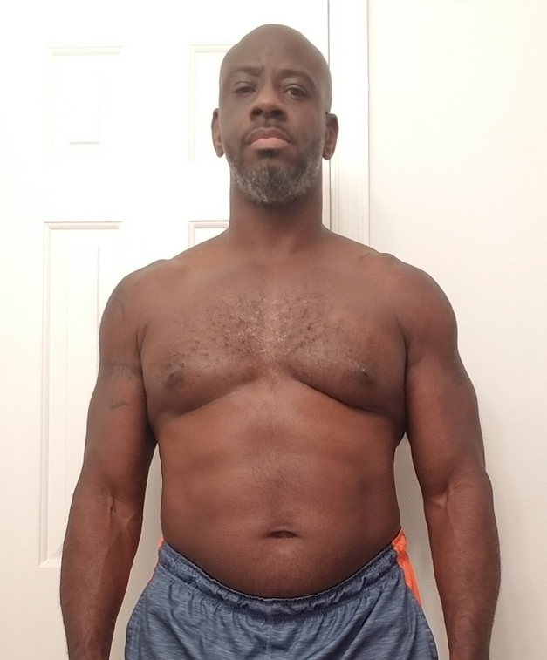
2021 Fall Challenge
GRAND CHAMPION
Leroy Windfield
28 total lbs. lost
“I feel healthier, younger, and have more energy and flexibility. At 52 years old, I was able to get back down to my weight I was when I was 25 and had my first MMA fight and 2 pounds shy of my 2nd fight weight, which was 198.”
Mfinity would never knowingly promote a questionable or false testimonial. Please note that the testimonials shared herein may be from independent distributors that seek to benefit from the sales of referenced products.
The MFIT Challenge is a comprehensive system promoting an active ketogenic lifestyle, which includes meal replacement products and nutritional supplements along with dietary and exercise guidance. The average weight loss expectation is approximately 1-2 lbs. per week, up to 15 lbs. total. Any weight loss in excess of these amounts, although not uncommon, should not be considered as typical, and would require exceptional circumstances and or efforts. Individual results can and will vary dependent upon many factors

Slide 15
SUPERCHARGED
WITH THE MUSCADINE EFFECT

Slide 16
What is a Muscadine?
The BEST SUPERFRUIT on the planet!
Loaded with powerful antioxidants
$Millions in ongoing clinical research
Grown and bottled in the USA
Needs no herbicides or pesticides to thrive
An amazing story 400 years in the making
The CORE of Mfinity products
“One of the most powerful and most overlooked superfoods on the planet.”
Dr. Stephen Talcott
Professor Of Food Chemistry Texas A&M, Muscadine Health Expert
“These statements have not been evaluated by the FDA. Mfinity products are not intended to diagnose, treat, cure, or prevent any disease, nor should they be used as a substitute for any medication you may currently be using. We do not offer medical advice. Please consult with your medical professional before starting, stopping, or adjusting any medications.”

Slide 17
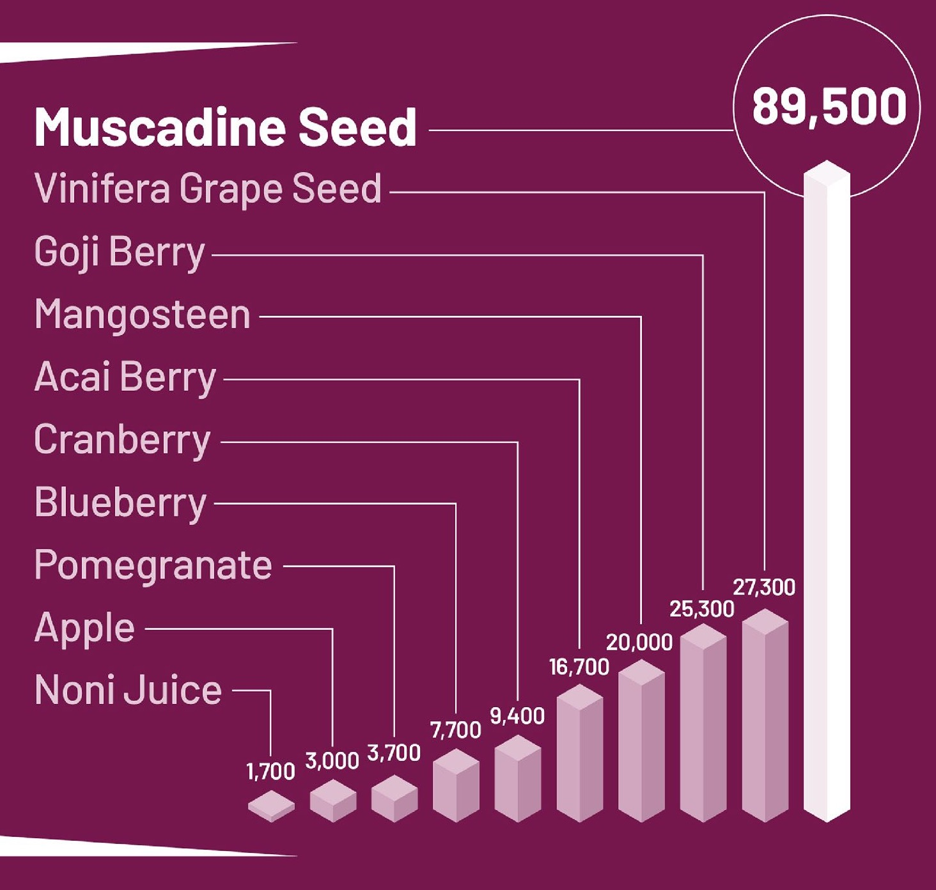
Highest ORAC Score
of These Popular Superfruits
ORAC, or Oxygen Radical Absorbance Capacity is a measure of a substances ability to neutralize Free Radicals for the purpose of comparison to other tested substances.
53x higher than Noni Juice
10x higher than Blueberry
5x higher than Acai Berry
4x higher than Mangosteen
ORAC ratings may vary from batch to batch. All ORAC ratings are measured by Brunswick Labratories, and are expressed as micromole TE per 100 grams.
“These statements have not been evaluated by the FDA. Mfinity products are not intended to diagnose, treat, cure, or prevent any disease, nor should they be used as a substitute for any medication you may currently be using. We do not offer medical advice. Please consult with your medical professional before starting, stopping, or adjusting any medications.”

Slide 18
The Muscadine Effect
Skin Elasticity
Gut Probiotics
Allergic Response
A Rich Cache of Antioxidants
Known to Support
Brain Function
Anthocyanidins
Anthocyanin
Apigenin
Caffeic Acid
Catechin
Catechin Gallate
Chlorogenic Acid
Coumaric acid
Cyanidin
Delphinidin
Ellagic Acid
Ellagitannins
Epicatechin
Epicatechin Gallate
Epigallocatechin
Epigallocatechin Gallat
Ferulic Acid
Gallic Acid
Kaempferol
Malvidin
Myricetin
Oligomeric Proanthocyanidin
Pelargonidin
Peonidin
Piceatannol
Polymeric Proanthocyanidin
Proanthocyanidin
Protocatechuic Acid
Quercitin
Resveratrol
Vanillic Acid
Inflammatory Response
Sustained Energy
Blood Chemistry
Sexual Response
Joint Flexibility
Restful Sleep
Weight Loss
Stress Response
Blood Flow
Immune Response
“These statements have not been evaluated by the FDA. Mfinity products are not intended to diagnose, treat, cure, or prevent any disease, nor should they be used as a substitute for any medication you may currently be using. We do not offer medical advice. Please consult with your medical professional before starting, stopping, or adjusting any medications.”

Slide 19
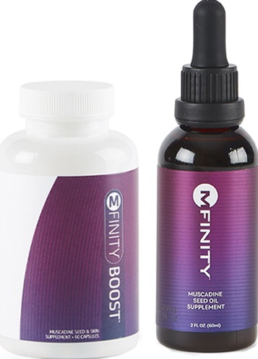
MFINITY Oil &
MFINITY Boost
100% pure Muscadine Seed Oil
100% pure Muscadine Seeds & Skin
Inhibits the formation and storage of body fat
Supports and nourishes healthy looking skin
Turn back time with the power of Muscadine
“These statements have not been evaluated by the FDA. Mfinity products are not intended to diagnose, treat, cure, or prevent any disease, nor should they be used as a substitute for any medication you may currently be using. We do not offer medical advice. Please consult with your medical professional before starting, stopping, or adjusting any medications.”

Slide 20
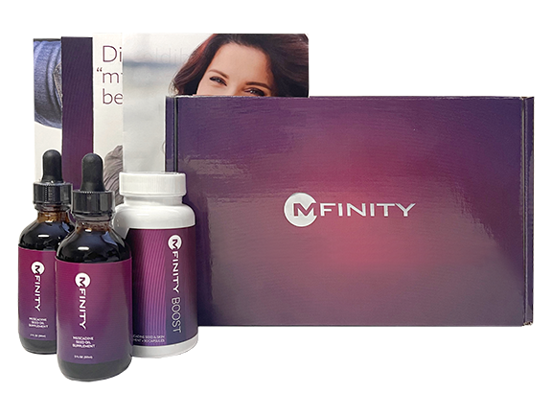
MEET YOUR NEW BFF!
MFINITY Timeless Box
B – BEST Antioxidant
F – FAT Blocker
F – FOUNTAIN of Youth
2 MFINITY Oils
MFINITY Boost
Marketing Materials
$192.90 value – ONLY $99.95

Slide 21
CORE HEALTH PACKS
Give your body what it needs to repair, rebuild, and restore itself every day.
Core Health Packs contain potent superfoods, supplements, and nutritional hydration.
Neutralize free-radicals*
Support healthy digestion*
Fight inflammation*
Promote beautiful skin*
Enjoy healthy energy*
Initiate daily detoxification*
“These statements have not been evaluated by the FDA. Mfinity products are not intended to diagnose, treat, cure, or prevent any disease, nor should they be used as a substitute for any medication you may currently be using. We do not offer medical advice. Please consult with your medical professional before starting, stopping, or adjusting any medications.”

Slide 22
FAT LOSS & FITNESS
Access your body’s natural fat burning mode and watch the pounds and inches melt away!
Fat Loss/Fitness Packs include Core Health products and our delicious FUEL meal replacement shake and BURN capsules.
CORE HEALTH benefits plus:
Support healthy fat loss*
The world’s most delicious shake
Promote heightened activity*
“These statements have not been evaluated by the FDA. Mfinity products are not intended to diagnose, treat, cure, or prevent any disease, nor should they be used as a substitute for any medication you may currently be using. We do not offer medical advice. Please consult with your medical professional before starting, stopping, or adjusting any medications.”

Slide 23
SUBSCRIBE AND SAVE!
With Mfinity Rewards, receive up to $80 a month in FREE Product Credit which can be redeemed for any product in our catalog!
To join, just set up a monthly subscription order. You’ll start receiving FREE product credit right away!
“I love the MFIT Rewards program. It’s very convenient and I’ve received over $1500 in FREE products. I definitely rate it 5 Stars!” - Wanda K

Slide 24
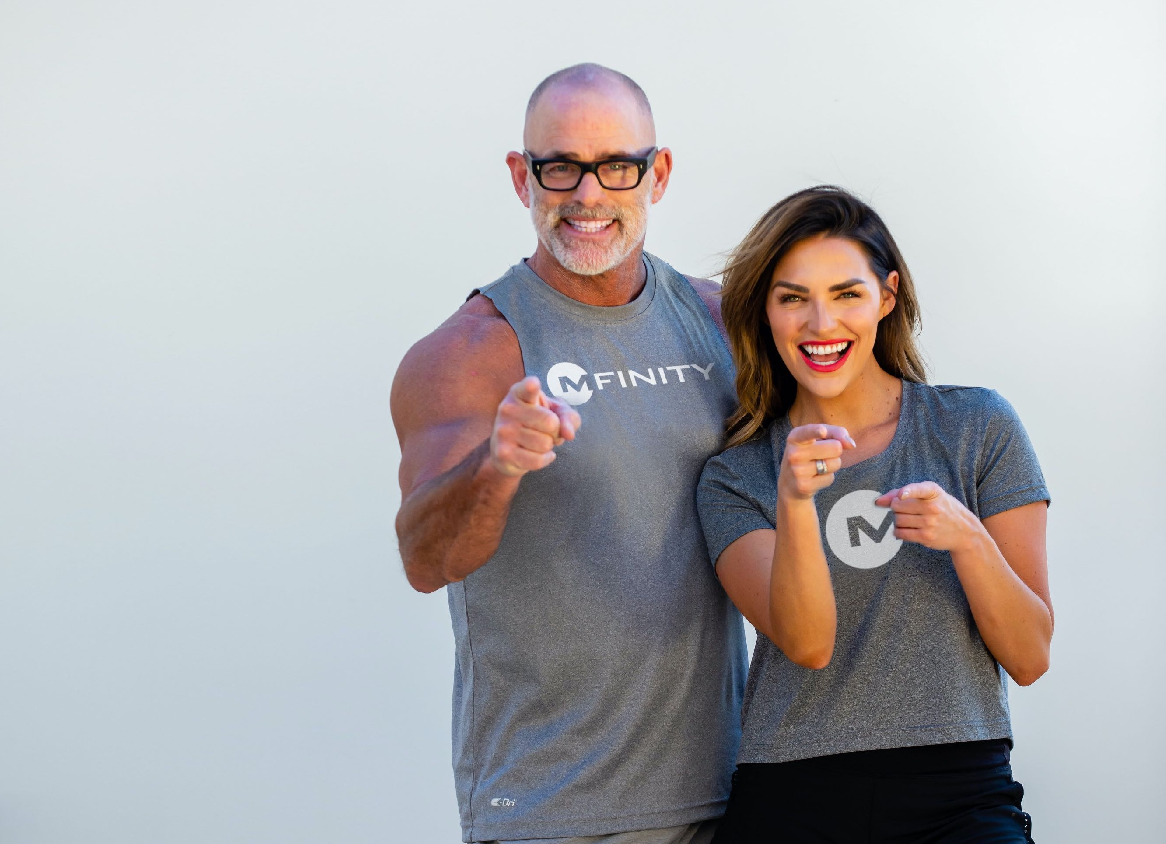
NOW, LET’S TAKE IT TO THE NEXT LEVEL…
If you’re ready to look better, feel better and turn back time - It’s easier than you think!
Pick your pack,
Choose your focus,
Join our Community!

Slide 25
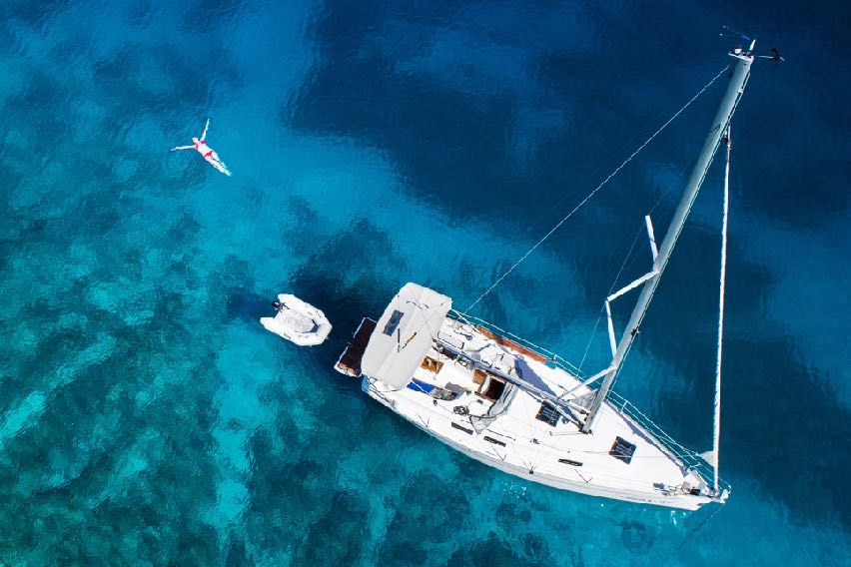
Have you ever wondered what it would be like to Own Your Life?
And do WHAT you want, WHEN you want, with WHOM you want?

Slide 26
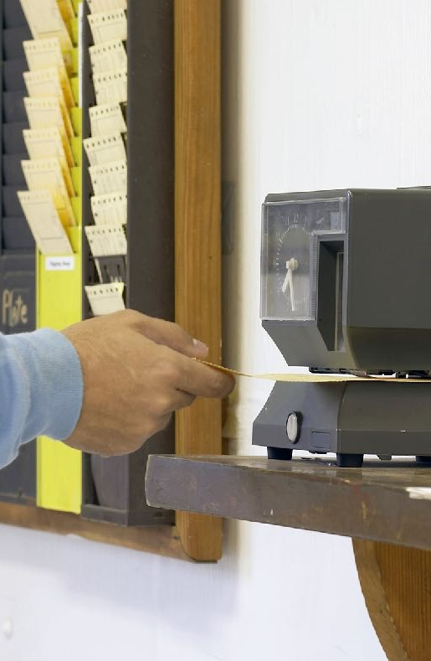
The Challenge is when you subtract the…
Sleeping Time
Working Time
Commuting Time
Everything Else
The Money
Most people don’t have the time to do what they really want to do…
and if they did, would they have

Slide 27
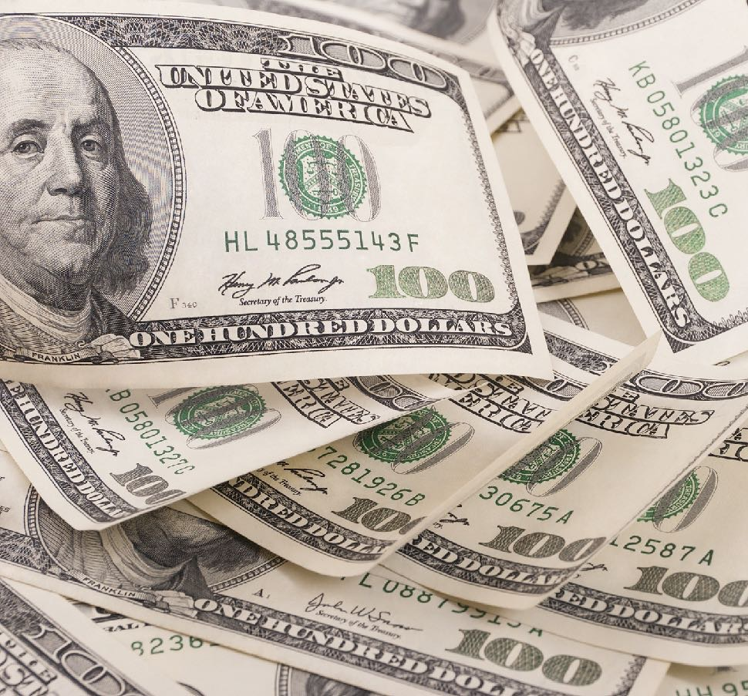
To Own Your Life you need 3 things:
HEALTH
WEALTH
TIME FREEDOM

Slide 28
Gone are the days…
Getting a Degree
Getting a good job
Getting a gold watch
Getting a life-long pension

Slide 29
We discovered a way that you can Own Your Life by building a home-based business.
We have a simple system
Anyone can do it
Doesn’t require selling
What’s best, it won’t take much of your time!

Slide 30
Our Revolutionary Business Model
+
=
Influencer Marketing
Network Marketing
Marketing

Slide 31
Influencer marketing is expected to grow to be worth $13.8 billion in 2021.
91% of millennials trust online reviews as much as friends and family

Slide 32
The best influencer marketing campaigns are very organic and do not look like advertising.
Friends influence 81% of consumers' purchasing decisions on social media

Slide 33
MADE FOR THE
MFINITY Timeless Box
50% Revenue Share!
That means $50 to YOU, the Mfluencer!

Slide 34
Now, it’s time to become an
Did you know you’re already an Influencer?
According to Influencer Marketing Experts, the Average Engagement Rate by Follower Count…
Type # of Followers Engagement
Nano 1K – 5K 3.69%
Micro 5K – 20K 2.25%
Mid-Tier 20K – 100K 1.62%
Macro 100K – 1MM 1.61%
Mega 1MM + 1.50%
!
“This illustration is for educational purposes only and is not intended to serve as a guarantee of income. Actual results will vary depending upon many factors. Success in this business requires hard work, dedication, and good sales skills. The average participant in this business earns between $500 and $2,000 per year. Some earn less while some earn much more. Please see our full income disclosure statement for more information.”

Slide 35
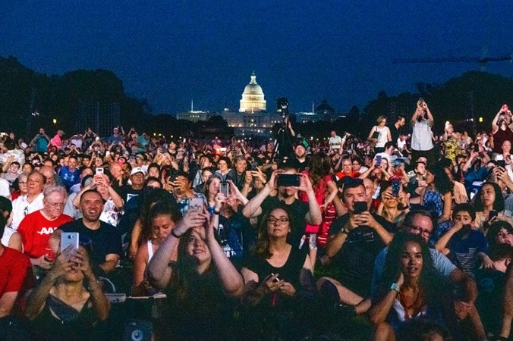
And no matter where you leverage your influence,
Social Media
Friends & Family
Community Events
Home Parties
Leagues & Clubs
Wherever People are…
Marketing will work for you!

Slide 36
No other system even comes close!
Weekly Bonuses (up to 50% of revenue)
Monthly Residual Income (for the life of the customer)
Generational Income (to unlimited depth)
Rank bonuses (up to $38,800)
Lifestyle Bonuses (up to $1,000 a month)
Global Bonus Pools (of all global business volume)
“This illustration is for educational purposes only and is not intended to serve as a guarantee of income. Actual results will vary depending upon many factors. Success in this business requires hard work, dedication, and good sales skills. The average participant in this business earns between $500 and $2,000 per year. Some earn less while some earn much more. Please see our full income disclosure statement for more information.”

Slide 37
Join the
REVOLUTION
Option A
Enrollment Kit $49.95
Commissions ID Number
Marketing Website & Shopping Cart
Back Office & Reporting
Unlimited Ambassador & Customer Support
Purchase products at wholesale Ambassador price
FREE with Starter Pack or Timeless Box Purchase!

Slide 38
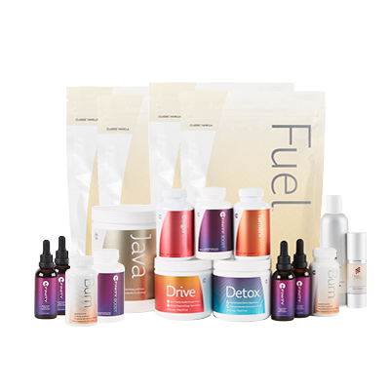
Join the
REVOLUTION
Option B - Pick Your Product Starter Pack
Your Enrollment is FREE! (Save $49.95)
TIMELESS BOX
BASIC STARTER PACK
SUPER STARTER PACK
ULTIMATE STARTER PACK
All Starter Packs automatically setup auto-shipment of corresponding monthly pack*
“Please note that personal product purchases and or personal or downline customer or distributor auto-shipment of products is/are not required to participate in or to receive full benefit of Mfinity’s compensation plan. Please see full compensation handbook for more details and other information.”

Slide 39
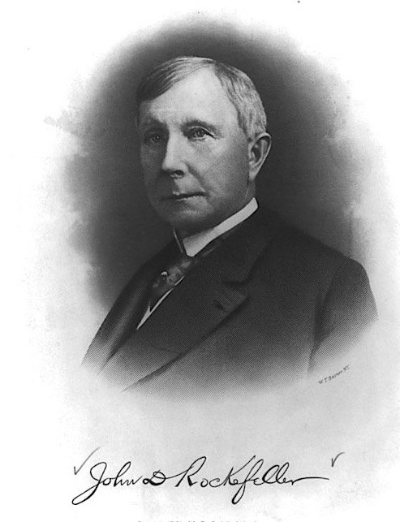
THE POWER OF LEVERAGE
“I’d rather have 1% of the efforts of a hundred men, then 100% of my own efforts.”
– John D. Rockefeller
“This illustration is for educational purposes only and is not intended to serve as a guarantee of income. Actual results will vary depending upon many factors. Success in this business requires hard work, dedication, and good sales skills. The average participant in this business earns between $500 and $2,000 per year. Some earn less while some earn much more. Please see our full income disclosure statement for more information.”

Slide 40
LEVERAGE YOUR MFLUENCE
EXAMPLE:
Enrolling Customers with:
Mfinity Timeless Box for $99.95
1ea. Mfinity Boost Capsules 90ct
2ea. Mfinity Oil 30ml
For each Box sold you’ll receive:
Mfluencer Bonus: $50.00
2 boxes per week = $400 / Mo
1 box per day = $1,400 / Mo
5 boxes per day = $7,500 / Mo
$100,000 = 2,000 boxes
$500,000 = 10,000 boxes
$1,000,000 = 20,000 boxes
Whether you’re a mega-influencer, middle-influencer, or a micro-influencer, you’ll get paid every time your customers purchase product – for life!
Get paid with each Customer:
Mfluencer Bonus
Starter Pack Bonus
Customer Commissions
Ongoing Residuals
“This illustration is for educational purposes only and is not intended to serve as a guarantee of income. Actual results will vary depending upon many factors. Success in this business requires hard work, dedication, and good sales skills. The average participant in this business earns between $500 and $2,000 per year. Some earn less while some earn much more. Please see our full income disclosure statement for more information.”

Slide 41
LEVERAGE OTHER MFLUENCERS
EXAMPLE 1:
As a micro-Mfluencer, if you sold 2 Timeless Boxes per day, and enrolled only 2 others who did the same six levels deep, your overall monthly income would look like this:
Personal Mfluencer Bonus: $3,000.00
Level Mfluencers Override
1 2 $228.00
2 4 $456.00
3 8 $456.00
4 16 $912.00
5 32 $1,824.00
6 64 $2,188.80
7 128 $2,918.40
GRAND TOTAL $11,983.20
However, if add just one more Mfluencer…
Override Commissions (to unlimited depth)
Generational Income (to unlimited depth)
Rank bonuses (up to $38,800)
Lifestyle Bonuses (up to $1,000 a month)
“This illustration is for educational purposes only and is not intended to serve as a guarantee of income. Actual results will vary depending upon many factors. Success in this business requires hard work, dedication, and good sales skills. The average participant in this business earns between $500 and $2,000 per year. Some earn less while some earn much more. Please see our full income disclosure statement for more information.”

Slide 42
LEVERAGE OTHER MFLUENCERS
EXAMPLE 2:
As a micro-Mfluencer, if you sold 2 Timeless Boxes per day, and enrolled only 3 others who did the same six levels deep, your overall monthly income would look like this:
Personal Mfluencer Bonus: $3,000.00
Level Mfluencers Override
1 3 $342.00
2 9 $1,026.00
3 27 $1,539.00
4 81 $4,617.00
5 243 $13,851.00
6 729 $24,931.80
7 2187 $49,863.60
GRAND TOTAL $99,170.40
Override Commissions (to unlimited depth)
Generational Income (to unlimited depth)
Rank bonuses (up to $38,800)
Lifestyle Bonuses (up to $1,000 a month)
“This illustration is for educational purposes only and is not intended to serve as a guarantee of income. Actual results will vary depending upon many factors. Success in this business requires hard work, dedication, and good sales skills. The average participant in this business earns between $500 and $2,000 per year. Some earn less while some earn much more. Please see our full income disclosure statement for more information.”

Slide 43
Global Residual Bonus Pools
LEVERAGE ALL MFLUENCERS
3%
Emerald
Pool
3%
Diamond
Pool
12% of ALL Product Business Volume is placed into 4 pools:
Emerald Pool
Diamond Pool
Blue Diamond Pool
Black Diamond Pool
3%
Blue Diamond Pool
3%
Black Diamond Pool
The higher your rank, the bigger your share!
“This illustration is for educational purposes only and is not intended to serve as a guarantee of income. Actual results will vary depending upon many factors. Success in this business requires hard work, dedication, and good sales skills. The average participant in this business earns between $500 and $2,000 per year. Some earn less while some earn much more. Please see our full income disclosure statement for more information.”

Slide 44
The Time is NOW
We are looking for great people to help us take MFINITY to the World!
No experience necessary
No employees
No territories
No inventory
No income limits
“This illustration is for educational purposes only and is not intended to serve as a guarantee of income. Actual results will vary depending upon many factors. Success in this business requires hard work, dedication, and good sales skills. The average participant in this business earns between $500 and $2,000 per year. Some earn less while some earn much more. Please see our full income disclosure statement for more information.”

